Slide 1
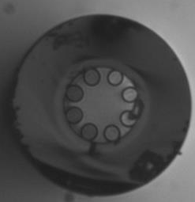

Slide 4
9.06 µm
10.0 µm
9.91 µm
5
6
11.0 µm
4
7
9.54 µm
10.5 µm
3
8
2
10.8 µm
1
9.59 µm
CAPILLARIES | Height Diameter (um) | Width Diameter (um) | Thickness (nm)
1 | 9.45 | 9.42 | 200
2 | 10.00 | 9.06 | 200
3 | 10.30 | 9.51 | 200
4 | 11.00 | 9.91 | 200
5 | 10.80 | 9.69 | 200
6 | 10.80 | 9.59 | 200
7 | 10.30 | 10.20 | 200
8 | 11.00 | 9.91 | 200

Slide 5
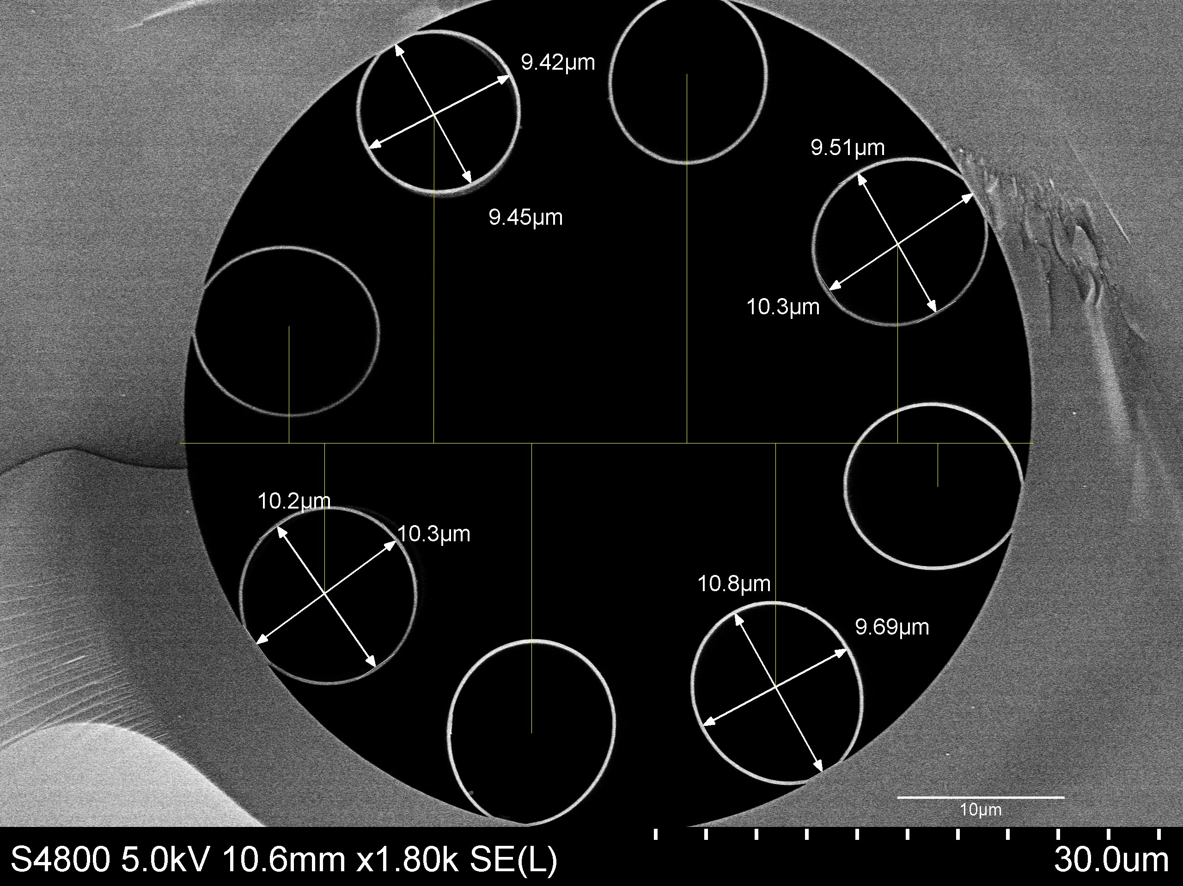
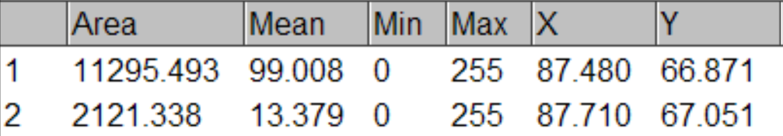
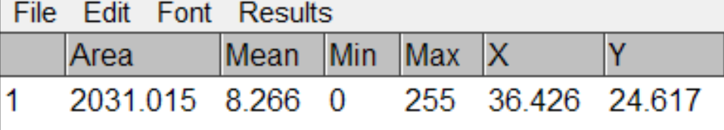
9.09 µm
10.02 µm
9.88 µm
19.67 µm
10.88 µm
22.1 µm
11.9 µm
7.0 µm
9.69 µm
6.2 µm
14.9 µm
20.76 µm
30.04 µm
42.65 µm
45.04 µm
8.38 µm
9.0 µm
35.33 µm
10.4 µm
2.6 µm
17.35 µm
14.6 µm
10.96 µm
9.57 µm
Total Diameter: 119 um
Hollow Diameter: 51 um
Darker Thickness: 7 um
Capillary Thickness: 200 nm

Slide 6
